Slide 1

Parkinsson Disease Classification
Afnan Mhran - Ahmad Jabali -Rahaf Al-Qahtani

Slide 2
Outline
Introduction
Problem
Data preparation
Model training and testing
The model
Results

Slide 3

Introduction
Parkinson Disease (PD): is the degenerative illness of the brain that affects patients’ ability to perform a well-learned motor task such as walking, body balancing as well as writing appropriately (Morris and Lansek, 1996). Unfortunately, PD affects a significant portion of the global population. This disease affects about 1% of individuals over the age of 55.
Parkinson's Disease Deaths in Saudi Arabia reached 0.58% of total deaths

Slide 4
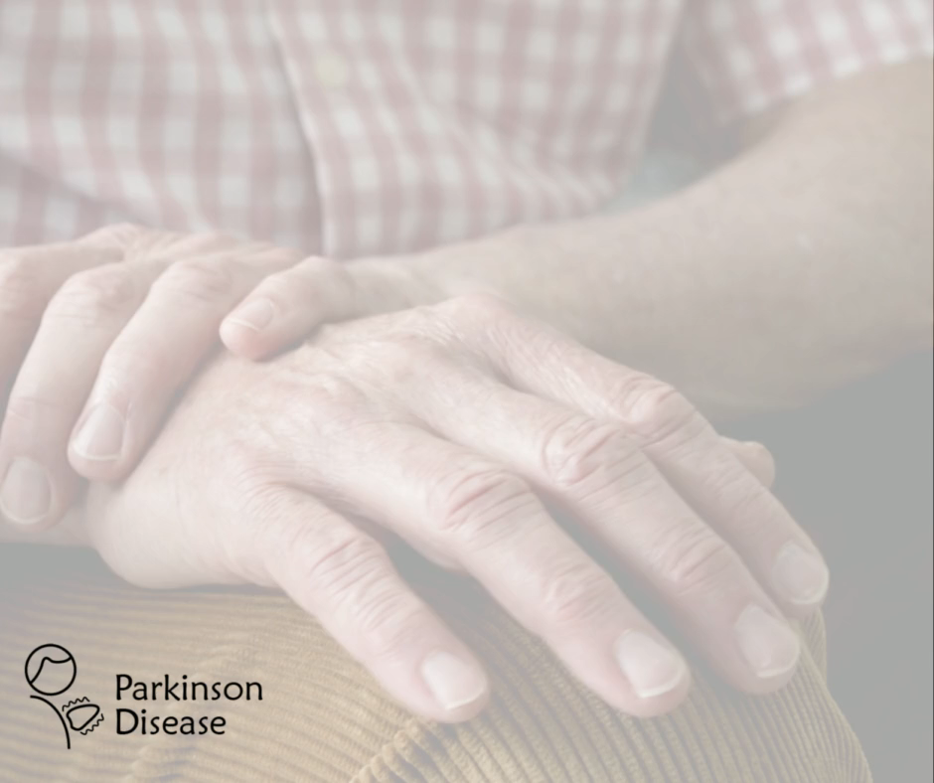
Problem
Parkinson's disease is notoriously difficult to accurately diagnose, with misdiagnosis rates as high as 25% of cases. The strategies outlined in this work aim to effectively and accurately classify healthy individuals from affected ones.

Slide 5
Data Preparation
Data Source: Kaggle
Data preparation:
Renaming variables for simpler observing.
Reordering columns.
Oversampling
Dropping columns correlated with the target column

Slide 6
Model training and testing
Training:
Testing:
Data splitting
Binary classification sequential deep learning model consist of four dense layers
“Adam” Optimizer was considered
The model trained on 100 epochs
Accuracy
Precision
Recall
F1 score

Slide 7
Show your model
App development:
Flask for backend
Flutter for frontend

Slide 8
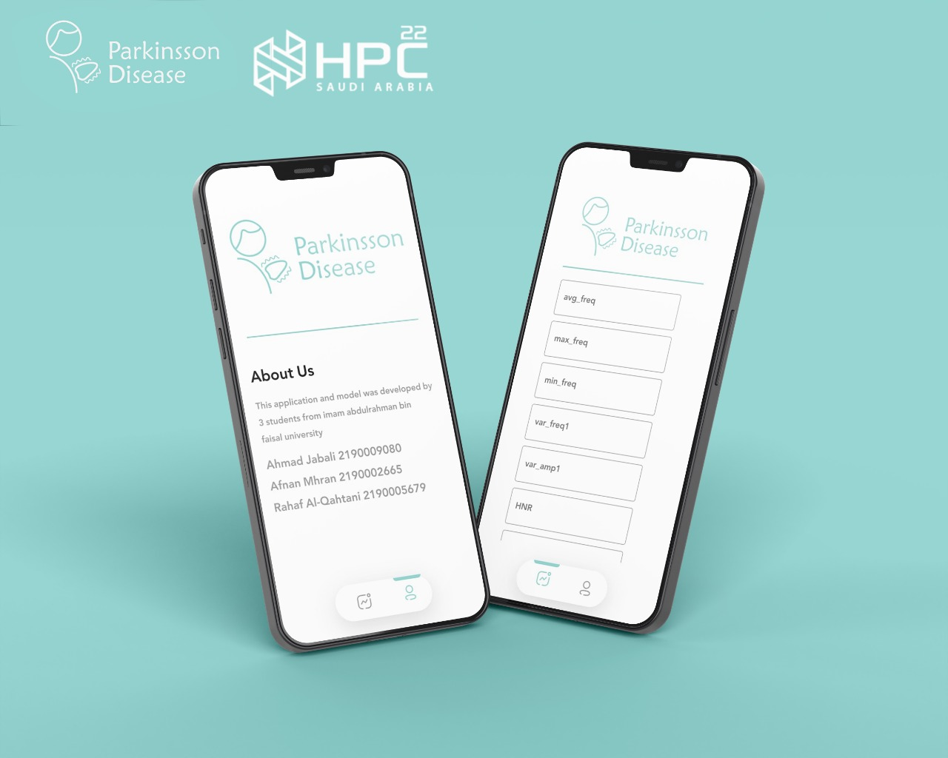
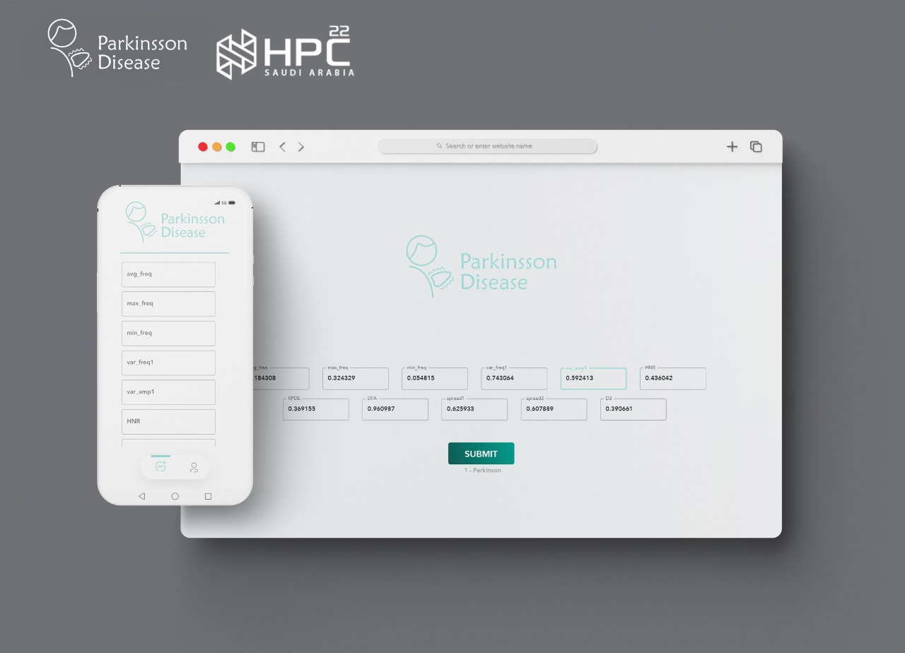

Slide 9
Results
F1 Score
Precision
88%
86%
90%
95%
Accuracy
Recall

Slide 10
Challenges
Difficulty in communication and arranging for meetings
Using Deep learning for first time
Deploy the model and connect the model with Flutter framework to build Android, ios, desktop and web application by using Flask as backend

Slide 11
Next step
Training the model on larger saudi dataset.
A modification of nural network’s sturcure to preduce more accurate model.
Feature selection may involve in the porcess.
Link the model to Flask, then connect it to a server.
Let’s improve it !

